Slide 1

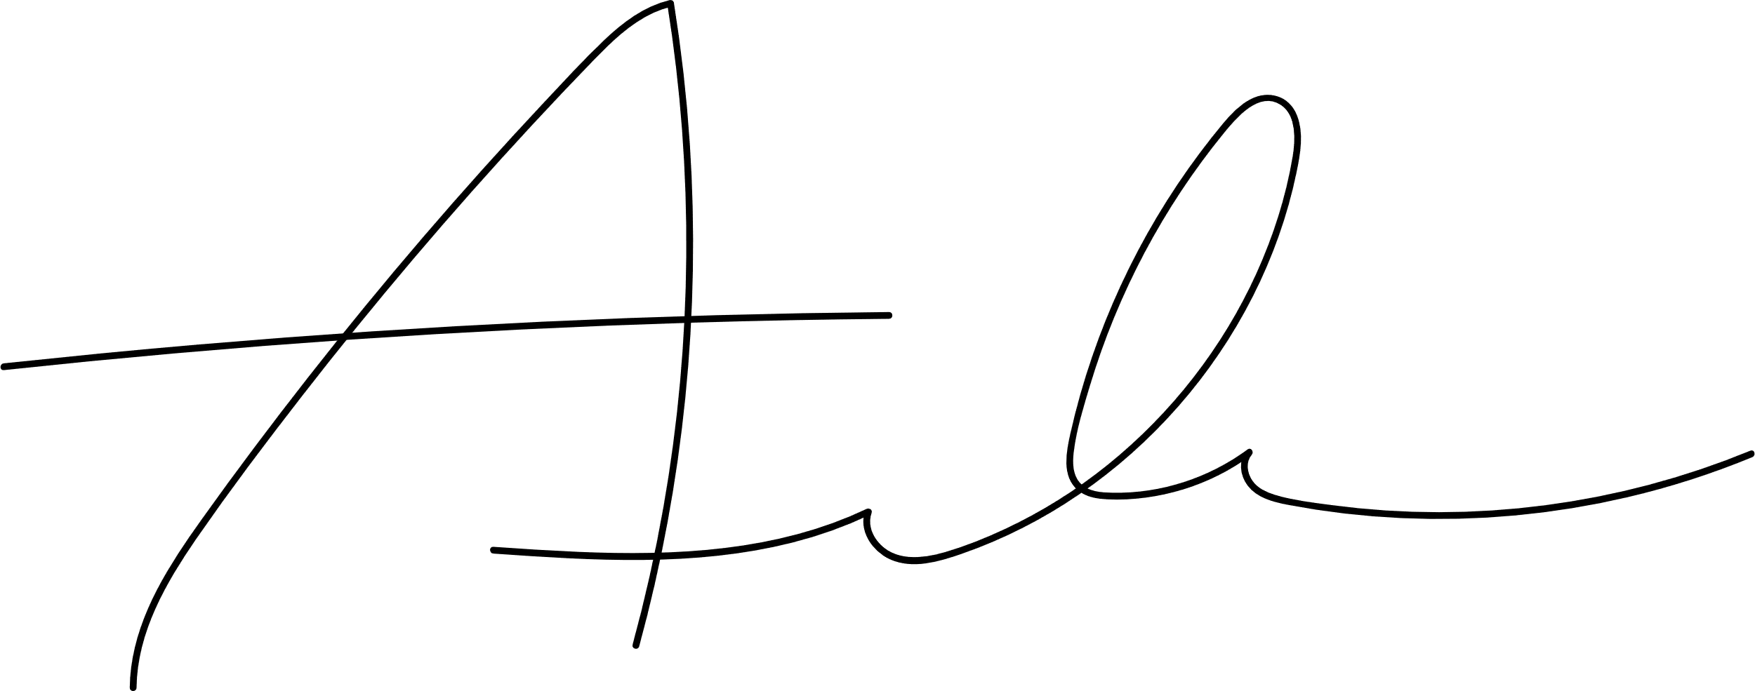

<FullName>
Certificate of completion
This is to certify that
has completed the <EventType> entitled <Topic>. Completed on <Date>
Anshu Benjaree
Aiko Watanabe
Vice President
Director

